Slide 1
The Battle for Data Protection in AI and Data Analytics in Today’s World
Kellyn Gorman
Engineer and Advocate, Redgate

Slide 2

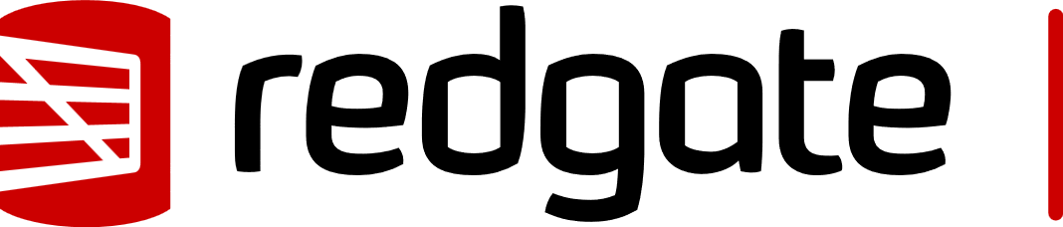


About me
Kellyn Gorman
Engineer and Advocate
Kellyn.Gorman@red-gate.com
https://linkedin.com/in/kellyngorman
https://dbakevlar.com
Notes:
Retrieval Augmented Generation is a process that enhances LLM output by retrieving and incorporating relevant information from external sources before generating a response.
Where Agentic RAG combines RAG with AI agents to make autonomous decisions. They’re more flexible, create adaptable workloads with integrated tools such as APIs, databases and external functions and products.

Slide 3

Agenda
AI Fears
Current Landscape
The AI Hall of Shame(ongoing)
Easy Access AI
Bigger Picture AI

Slide 4

AI is a Scary Place

Slide 5

Current Risks…
Unauthorized Data Access & Exposure
Hallucinations and Data Fabrication
Lacking Governance
Regulatory Compliance Challenges
3rd Party AI Dependencies

Slide 6

How Agentic AI has changed the game…
Generic RAG(Retrieval Augmented Gen) processes vs. Agentic RAG?
Not just returning a response but acting on a response.
How this can be hijacked?
https://www.harmonic.security/resources/from-payrolls-to-patents-the-spectrum-of-data-leaked-into-genai

Slide 7
Additional Risk with Agentic AI
Intelligent Exploitation of Vulnerabilities
Data Exfiltration and Evasion
Large-Scale Data Scraping & Poisoning
AI-Driven Social Engineering
AI-Augmented Credential Stuffing and Brute Force Attacks
Synthetic Identity and Fraudulent Transactions
Insider Threat due to Shadow AI

Slide 8
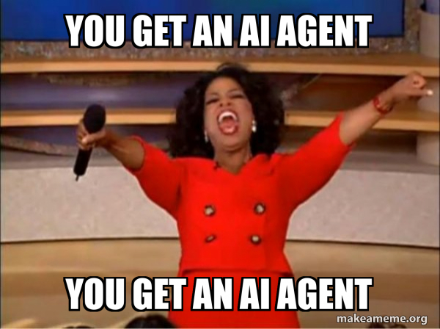
Oh Yeah, One Other Thing…

Slide 9
First Story for the AI Hall of Shame…
Spring 2024
Loads Leasing Info data into Open-Source AI
This is a shadow AI project- no IT governance.
160K user and financial records now exposed.
Notes:
I was brought in to advise on clean up and elimination of threat.
Had to explain that once the data was exposed, there was no way to remove it from public AI

Slide 10
It’s a Rare Occurrence, RIGHT??
8.5% of GenAI prompts included sensitive data in Q4 2024
Over 45% included customer data, such as billing info, customer reports and authentication information.
Over 25% was employee data, including payroll, PII and employment records.
7% was security policies and reports.
6% was proprietary source code and access keys.
Over 60% was discovered in the free tier of ChatGPT
https://www.harmonic.security/resources/from-payrolls-to-patents-the-spectrum-of-data-leaked-into-genai

Slide 11
ChatGPT on its Own
Percentage of Employees
Source: Cyberhaven.com

Slide 12
AI Hall of Shame: AI Confidential
An AI-powered chatbot trained on internal documents at a major corporation was mistakenly exposed to the public. Employees, thinking it was private, began asking it questions about confidential projects, financials, and even unreleased product details—all of which were indexed by search engines before the company realized what had happened.
Lesson: AI chatbots should have strict access controls… unless you want your roadmap leaked via Google Search.

Slide 13
AI can be Brutal
Logistics startup Flexport filed a lawsuit against Freightmate AI for using AI to steal source code and establishing a company.
DarkSeek, which uses DeepSeek’s flagship AI model to expose vulnerabilities and raises concerns about potential data breaches.
The average company is leaking sensitive data to ChatGPT and other publicly available AI solutions hundreds of times each week, with increases monthly of over 55%!

Slide 14
Why Is this Happening?

Slide 15
AI models require large datasets for training
Without proper controls, or when controls are over-ridden, PII, GDPR and other data can be breached by AI.
Much is unintentional
Leaked data via AI can expose organizations to breaches or prompt injection once discovered.

Slide 16
A Small Delay Does Decrease Risk
EU Artificial Intelligence Act (AIA)
National Artificial Intelligence Initiative Act of 2020 (US, H.R. 6216)
AI in Government Act(US, H.R. 2575)
Advancing American AI Act (US, S. 1353)
14 states passed legislation between 2016-2022
Over 3000% increase in AI related laws between 2022 and 2024
Notes:
Further laws to be aware of:
Federal Aviation Administration Reauthorization Act which requires review of all AI in aviation.
National Defense Authorization ACT as of 2019, which appointed a coordinator to oversee all AI activities involving defense contracts.
The NAIIA focused on expanding AI research and dev. It’s supposed to oversee and implement the US National AI strategy, but many concern that political and financial interests have overtaken the committee.
Various state legislation, including Colorado, California, Connecticut and Texas. Over 85 bills are currently being reviewed.

Slide 17

Model Memorization and Data Retention
AKA Persisting Sensitive Data as LLMs learn
If past interactions influence responses, bad actors might extract confidential insights.
Lack of understanding and use of ephemeral sessions to avoid feeding sensitive data into prompts, as well as be aware of retention policies.
Code risks around Python and SQL

Slide 18
AI Hall of Shame: The “Smart” Redaction Failure
A legal AI tool was used to automatically redact sensitive information in legal documents before public release. Unfortunately, the AI only blacked out the text visually but left it searchable. Curious users simply copied and pasted the "redacted" sections into Notepad and revealed everything.
Lesson: AI is smart, but Ctrl+C, Ctrl+V is obviously way smarter.

Slide 19
To Hallucinate or Fabricate – the Future of AI
AI may become unusable in the next 3-5 years.
How much by bad actors, how much by too much data feeding AI.
Causes false or misleading information to be generated.
Can be exploited for fraud, misinformation or regulatory non-compliance

Slide 20
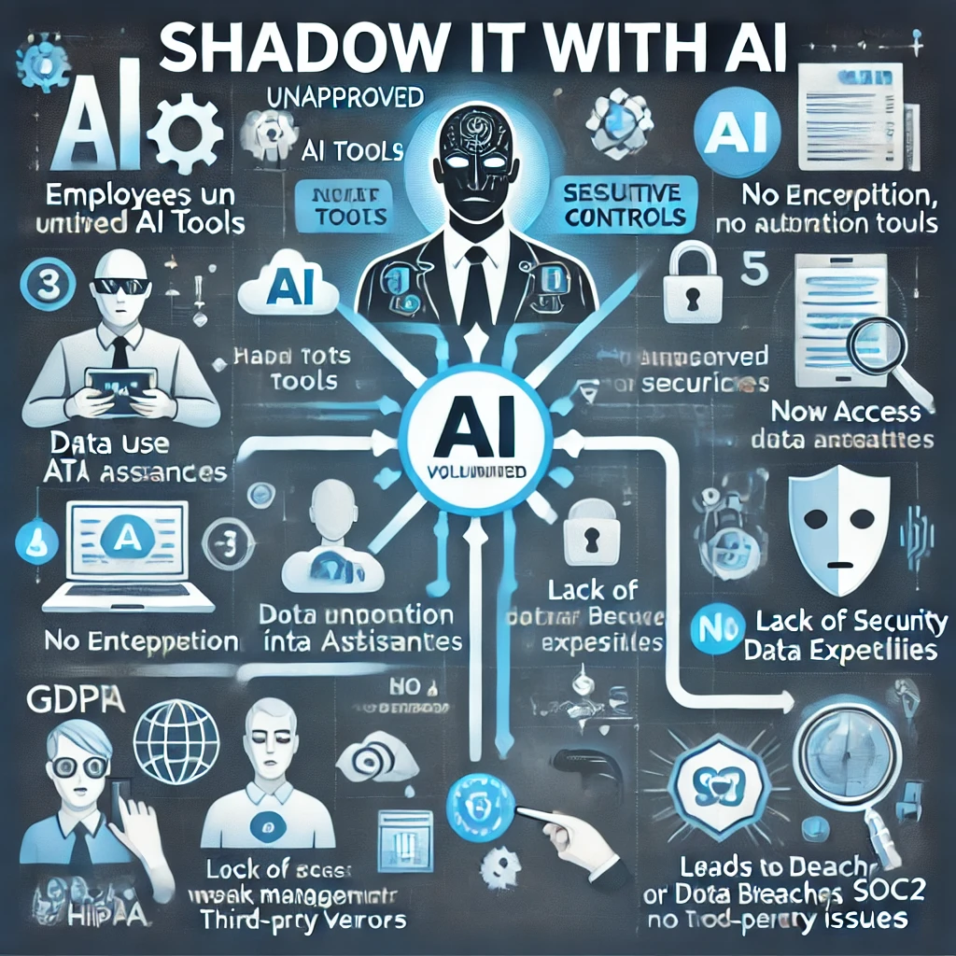
Does AI think we have a problem?

Slide 21

Shadow IT (SHADOW AI)
How many of the audience has had to manage a system that started out under someone’s desk?
AI is the new rogue production system.
Employees or organizations deploying AI without IT or security oversight, i.e. shadow AI, can create
compliance risks
data leaks
security vulnerabilities

Slide 22
Solutions to these threats
Strong AI Governance
Encrypted Data Handling
Strick Access Controls, including against Shadow AI
Robust Monitoring
Ongoing Compliance Audits
AI should enhance security, not be a mechanism to weaken it.

Slide 23
Establish AI Governance and Policies
Define clear AI usage policies that outline which AI tools are approved and how they can be used.
Require an approval process for ANY AI tool before employees can deploy them or use even open-source ones.
Implement a Responsible AI framework to ensure ethical and compliant AI usage.

Slide 24
Explainability Is a Legal Concern Now
In industries like finance and healthcare, it's no longer optional for AI models to be a "black box."
Laws like GDPR give people the right to an explanation if a decision is made about them by an algorithm.
Even when sensitive fields are removed, AI models can infer private information based on patterns in the rest of the data.
The EU AI Act and various U.S. state laws (like the California Privacy Rights Act) are introducing requirements for AI data governance, documentation, and risk mitigation. Compliance isn’t just for humans anymore.

Slide 25

Educate the Organization
Conduct regular training, (yes, more training!) on the risks of shadow AI.
1
Have compliance violations and data security risk assessments.
2
Promote the use of only approved AI tools and provide guidance for safe AI experimentation.
3

Slide 26
AI Hall of Shame: Too Polite Scam
An AI-generated phishing scam attempted to trick users by pretending to be a financial institution. However, the model had been trained on polite corporate emails and produced phishing messages that sounded too formal and apologetic, leading recipients to immediately suspect a scam.
Lesson: AI-generated phishing attempts still can’t replicate the right amount of urgency and rudeness as humans.

Slide 27
Enforce Access Controls and Monitoring
Use a robust Identify and Access Management (IAM) to control who can access AI tools.
Implement Data Loss Prevention(DLP) to monitor and restrict sensitive data sharing with AI systems.
Deploy SIEM(Security Information and Event Management) tools to detect unauthorized usage.

Slide 28
AI Discovery Tools
Along with shadow IT detection solutions, like Palo Alto Cortex Xpanse or MS Defender)
Implement cloud security posture management(CSPM) to track AI tools from cloud vendors, too.

Slide 29
Outside of Shadow AI…

Slide 30
3rd Party AI Dependencies
Lack of understanding and differences in 3rd party AI tools/providers, (OpenAI, Claude, CoPilot, Gemini, etc.)
All data is processed without a “black box” scenario so users can be accountable.
Clear understanding of the high risk of Shadow AI and public AI tools

Slide 31
AI Hall of Shame: AI Fell for Itself
A fraud detection system for a bank used an AI voice model to authenticate customer service calls. Hackers got into the system and used the same AI voice cloning tool to impersonate a high-level executive, successfully authorizing large money transfers.
The most frustrating part? The AI also mistakenly verified itself when tested internally, leading to weeks of confusion.
Lesson: When AI can’t tell the difference between truth and consequence.

Slide 32

AI Driven Attacks and Model Manipulation
Bad actors can manipulate or even poison AI models, (injecting misleading or incorrect data.)
May simply exploit model weaknesses
These can also extract confidential information.

Slide 33
Regulatory and Compliance Issues
AI decision making can lead to
biased outcomes
Non-compliant solutions
Unethical data usage
This can lead to potential legal risks, such as GDPR and CCPA violations.

Slide 34

Data Leakage
Notes:
Its not a data breach, per say, but an unintentional data exposure using AI tools such as OpenAI, Claude Sonnet, etc. Most tools offer SQL capabilities, which can lead to SQL injection risk, too.

Slide 35
Synthetic Data Can Reduce Risk—If Used Correctly
Synthetically generated data that mimics real data without exposing sensitive information is a powerful tool in the war for data protection.
AI can enhance rules-based solutions.
A promising solution for training ML models without risking privacy—but only if it's validated to avoid leaking patterns or poisoning production LLMs.

Slide 36
AI Hall of Shame: Public Security Footage
A smart security system using facial recognition was set up to protect sensitive areas in an office building. However, the system’s cloud storage was misconfigured, making all security footage publicly accessible.
The footage included:
Employees sneaking naps in empty meeting rooms
Executives air-guitaring in their offices
Individuals playing computer games.
Lesson: AI can detect intruders, but it can’t stop IT from misconfiguring tech.

Slide 37
To Combat All of This
AI-driven threat detection and anomaly monitoring
Level appropriate training for users, development, and even operations.
Advanced testing before it gets to users
Continual security awareness, heavily augmented with AI tools

Slide 38
Create Safer AI Adoption – Both Internal and Open-Source
Have a list of sanctioned AI tools with clear security to prevent employees from seeking alternatives.
Consider creating a centralized AI platform to safely perform AI experimentation for trusted individuals.
Principle of Least Privileged works for AI just as it does for database technology.
Monitor and sanitize Inputs and Outputs
Utilize rights, privileges and access controls at every tier of AI.
Enforce data classification, data masking and subsetting to limit risk in environments.

Slide 39
AI Hall of Shame: AI the Hacker
Security researchers have shown that LLMs like ChatGPT can be coaxed into writing polymorphic malware
Wrote code that then rewrote itself to evade detection.
This isn’t a single breach, but the potential for AI-as-a-Service for hackers is REAL.
Combine this with social engineering and it’s a nightmares for datasec.
Lesson: We now live in an age where AI might not just put us out of a job, but out of business.

Slide 40

So Be Proactive
Because if you don’t talk to your organization about AI and Data Protection, who will?

Slide 41
Thank you!
Kellyn Gorman
Engineer and Advocate, Redgate

